Slide 1
Analyses of intervention effects
Mark Scheuerell
FISH 507 – Applied Time Series Analysis
7 March 2017

Slide 2

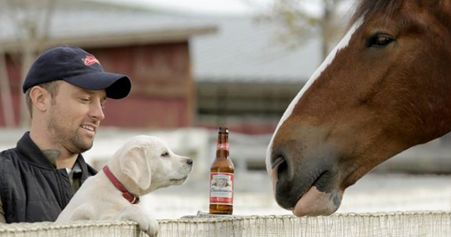
Big question in the finance world
What is the effect of advertising on sales?
Anheuser-Busch
spends $35 million/yr
on Super Bowl ads
$95 million/yr in revenue
(170% return!)
©Budweiser
How do they know this?
Hartman et al (2015)

Slide 3
An example of sales data
Implement sales campaign

Slide 4
How much did sales change?

Slide 5
Model from finance world
Sales
State equation
Advertising effect
Indicator function
Hamilton (1989), West & Harrison (1997)

Slide 6
Model from finance world
State equation
Step change

Slide 7
Model from finance world
State equation
Continual change

Slide 8
Model from finance world
Sales
State equation
Advertising effect
Advertising expense
Hamilton (1989), West & Harrison (1997)

Slide 9
Model from finance world
State equation

Slide 10
Model from finance world
State equation

Slide 11


Model from finance world
What if the sales data were incomplete (e.g., they came from a subset of stores)?

Slide 12
Model from finance world
True sales
State equation
Advertising effect
Indicator function
Observation equation
Observed sales
Hamilton (1989), West & Harrison (1997)

Slide 13
What about interventions in obs?
It is entirely possible for their to be a change (intervention) in the observations
Field ecology (fisheries, ornithology)
Laboratory (microscopy, genetics, chemistry)

Slide 14
Model for change in observation
State equation
Observation equation
Intervention
effect
Indicator function

Slide 15
Model for change in observation
Observation equation

Slide 16
Model for change in observation
State equation
Observation equation
Effect on observation
Covariate (obsID, daylight)

Slide 17

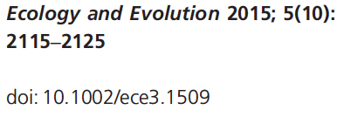

Slide 18
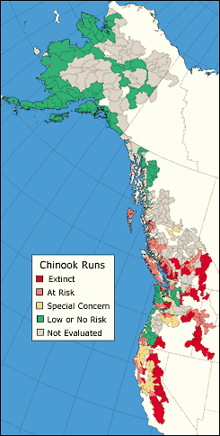
The salmon story
Major declines in populations across the continental U.S. & southern Canada
Evolutionary Significant Units (ESUs) form basis for conservation & management
28/52 ESUs listed as threatened or endangered under U.S. Endangered Species Act
Human (eg, dams, harvest) & natural (climate) causes have contributed to declines
Big money business ($4 billion per decade)
Source: State of the Salmon

Slide 19
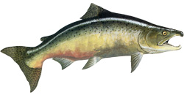

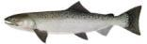
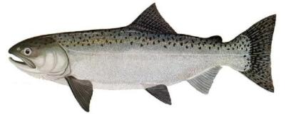
Recall the salmon life cycle
Eggs incubate
Adults spawn in freshwater
Parr rear
Massive
mortality
Smolts emigrate
Mature at sea

Slide 20
“Conservation” hatcheries
Adults
spawned
Eggs
incubated
Adults return to freshwater
Parr
reared
Fish
released
Smolts emigrate
Mature at sea

Slide 21
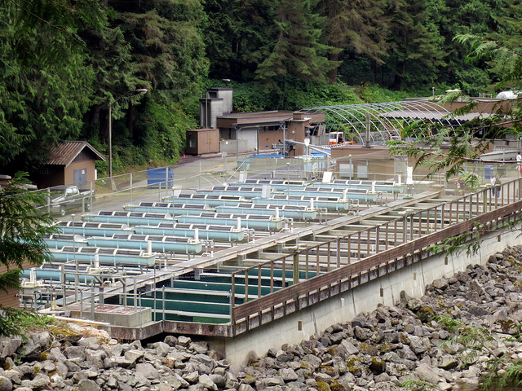
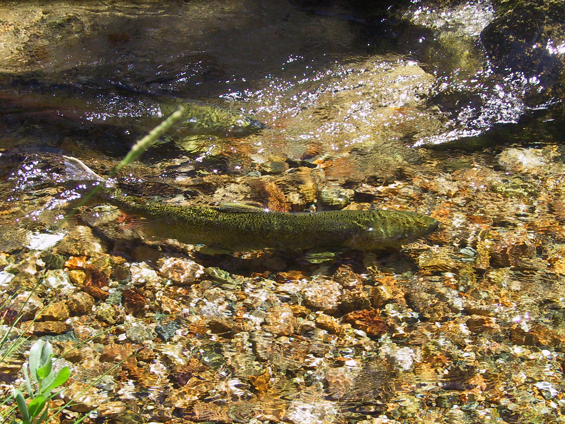
Adverse effects of hatcheries
Growing evidence that hatchery fish have reduced fitness & adverse demographic effects
(eg, Araki et al. 2007, Buhle et al. 2009, Christie et al. 2014)
©Ruth Hartnup

Slide 22
The big picture
Issue
Despite decades of hatchery supplementation, no formal assessment exists at the ESU level.
Question
What is the effect of supplementation on Snake River spring/summer Chinook salmon at
population level, and
broader ESU scale?

Slide 23
Definition of “supplemented”
2000
2001
2002
2003
2004
2005
2006
2007
2008
2009
2010

Slide 24
Definition of “supplemented”
2000
2001
2002
2003
2004
2005
2006
2007
2008
2009
2010
Wild fish taken into hatchery & spawned

Slide 25
Definition of “supplemented”
Juveniles reared in hatchery
2000
2001
2002
2003
2004
2005
2006
2007
2008
2009
2010
Wild fish taken into hatchery & spawned
Smolts released from hatchery

Slide 26
Definition of “supplemented”
Hatchery born fish return to spawn in wild
Juveniles reared in hatchery
2000
2001
2002
2003
2004
2005
2006
2007
2008
2009
2010
Wild fish taken into hatchery & spawned
Smolts released from hatchery
Supplemented brood years

Slide 27
Definition of “supplemented”
Hatchery born fish return to spawn in wild
Juveniles reared in hatchery
Sum of brood year returns
2000
2001
2002
2003
2004
2005
2006
2007
2008
2009
2010
Wild fish taken into hatchery & spawned
Smolts released from hatchery
Wild born fish return to spawn

Slide 28
Map of study region

Slide 29
Time series of spawner density

Slide 30
Time series of supplementation

Slide 31
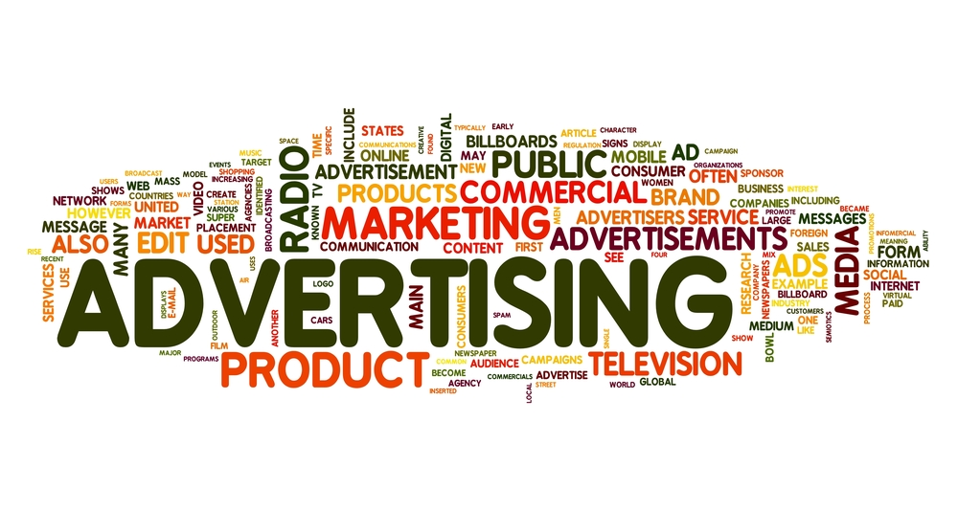
Model for supplementation
Wordcloud from Axess Multimedia

Slide 32
Model for supplementation
True density
State equation
Common year effect

Slide 33
Model for supplementation
True density
State equation
Supplementation effect
Indicator function

Slide 34
Model for supplementation
State equation

Slide 35
Model for supplementation
True density
State equation
Supplementation effect
Indicator function
Observation equation
Observed density

Slide 36
Versions of our models
Year effect
Supplementation effect
Markov
Random
Fixed
Random
Also allowed for supplementation effect on process and/or observation variance
Notes:
MAR(1) Workshop - ESA 2007, San Jose, CA
5 Aug 2007

Slide 37
Variance-covariance structure
For both process and observation errors
All popns share variance
Independent variance
σ
σ
Time
Time

Slide 38
Variance-covariance structure
For process errors only
Intervention only
Trend + intervention
Sup
Sup
σ
σ
Ref
Ref
Time
Time

Slide 39
Our “best” model structure
Year effect
Supplementation effect
Markov
Random
Fixed
Random
*No supplementation effect on process or obs. variance
Notes:
MAR(1) Workshop - ESA 2007, San Jose, CA
5 Aug 2007

Slide 40
Distribution of intervention sizes
Mean 95% CI Pr(+)
0.033 (-0.077, 0.15) 0.73
ESU-level:
Notes:
MAR(1) Workshop - ESA 2007, San Jose, CA
5 Aug 2007

Slide 41
Unintended supplementation
Notes:
MAR(1) Workshop - ESA 2007, San Jose, CA
5 Aug 2007

Slide 42
Year effects are much stronger
Notes:
MAR(1) Workshop - ESA 2007, San Jose, CA
5 Aug 2007

Slide 43
Spatio-temporal variation
Notes:
MAR(1) Workshop - ESA 2007, San Jose, CA
5 Aug 2007

Slide 44
Summary
Intervention models are used in many fields
Intervention models can take many forms

